Slide 1
Open Lifelong Learning
Gbemisola Ale, Kathy Essmiller, Caitlin Kelley, Marla Lobley

Slide 2
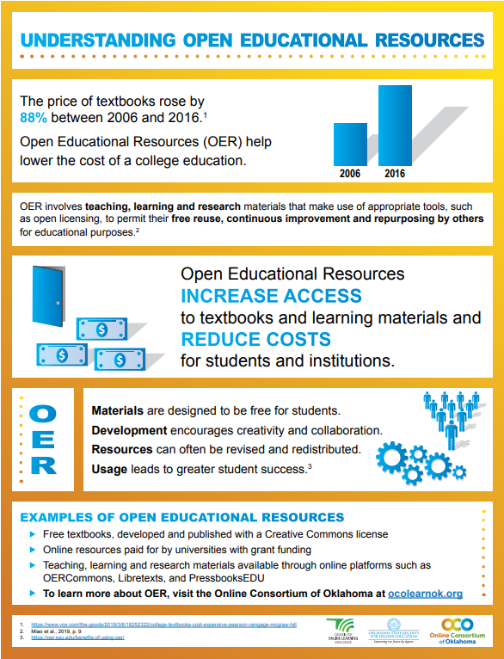
What is OER?
Openly licensed
Freely available
Learn more at ocolearnok.org/priorities/open-educational-resources/

Slide 3
Project Description
Grant through The Institute of Museum and Library Services (IMLS)
3-year research project evaluating an OER’s efficacy in developing lifelong learning competencies

Slide 4
Project Goals
Develop a Research toolkit
Increase number of robust academic studies
Increase diversity of the populations studied
Produce a Research methodology OER for librarians

Slide 5
Need for the Project
Hilton, 2019 review
OER outcomes typically limited to formal education settings (GPA, final grades, etc.)
Librarian research methodology training

Slide 6
Impact: Community Colleges
Diverse student populations
Community college employees wear many, many hats
IMLS grant = incentive for faculty!
Notes:
Diverse student populations
12% Native American (largest minority group)
78% part time students
Community college employees wear many, many hats
1 Librarian for 2500 students
Faculty have multiple roles
IMLS grant = incentive for faculty!

Slide 7
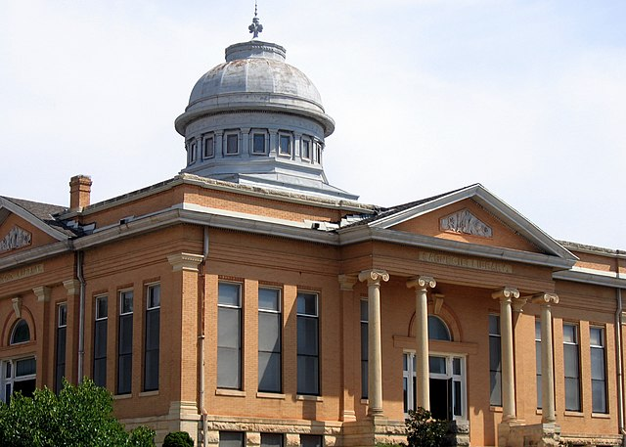
Impact: Public Libraries
Use OER in programming
Use lifelong learning as an outcome measure
Photo of Carnegie Library in Guthrie, OK by Winkywalrus is in the public domain. From Wikimedia Commons.

Slide 8
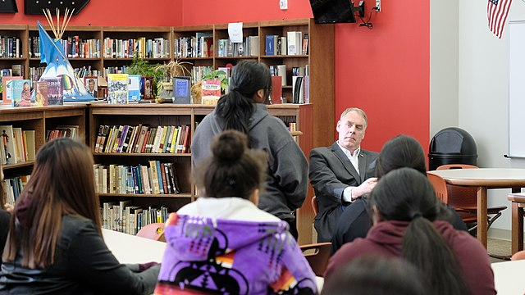
Impact: School Libraries
Potential research model for creating an instrument for K-12 use
Consolidated lifelong learning competencies
Photo of Riverside Indian School Library by the US Dept. Of the Interior is in the public domain. From Wikimedia Commons.

Slide 9
Lifelong Learning Competencies (so far)
Self-regulated learning
Social learning
Digital literacy
Goal setting
Critical thinking
Self-Efficacy
Notes:
Self-regulated learning: the ability for a learner to manage tasks, develop personal strategies to gain knowledge and assess them. Includes learner's reflection on their own learning and self-management.
Social learning: Learning in a community and learning to be in community. Includes cultural awareness and expression, social and civic competences and social and emotional skills.
Digital literacy: the ability of a learner to navigate digital forums and seek relevant knowledge with the use of information technology. Includes information literacy.
Goal setting: The use of an action plan by a learner to guide them towards acquiring certain skills and knowledge. Includes taking the intiative to pursue learning opportunities.
Critical thinking: the means to analyze and evaluate a subject, facts or information to arrive at a judgement. Includes transfering knowledge learned in one subject or domain to another.
Self-efficacy: The belief in one's own abilities. Includes the belief that one is capable of making changes.

Slide 10
Lifelong Learning Scales
Program for the International Assessment of Adult Competencies (PIAAC)
Effective lifelong learning scale (ELLLS)
Lifelong Learning Tendencies Scale
Lifelong learning competencies scale (LLLCS)
Notes:
Self-regulated learning: the ability for a learner to manage tasks, develop personal strategies to gain knowledge and assess them
Social learning: Learning by observing and imitating the immediate environment and the reinforcement of social constructs
Digital literacy: the ability of a learner to navigate digital forums and sought relevant knowledge with the use of information technology
Goal setting: The use of an action plan by a learner to guide them towards acquiring certain skills and knowledge
Critical thinking: the means to analyze and evaluate a subject, facts or information to arrive at a judgement

Slide 11
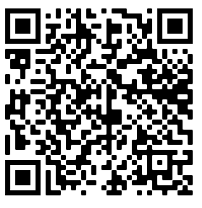
Discussion
What applications of OER do you see at your library?
How does a lifelong learning focus help connect OER to your library's mission and vision?
Link to Google Doc where you can type in your answer:​
Notes:
See group responses from the discussion at https://docs.google.com/document/d/15o7eyy_1B5iPO-0yX-Nz9E0qw_UM6uCsumbBl1_t81Y/edit?usp=sharing

Slide 12
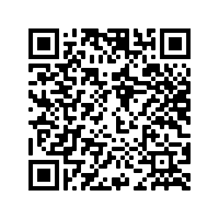
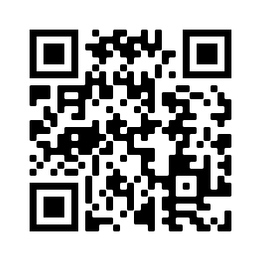
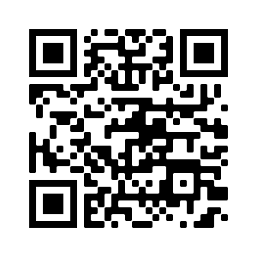
Resources
Handout describing the grant application process.
​
Follow the project and continue to give feedback on Twitter and Moodle!​
Handout
Twitter
Moodle
Notes:
The handout describes how we have collaborated on the grant proposal and what features of the proposal seemed most successful.
A major component of the project is to gather feedback from other professionals. We welcome all feedback at our Twitter and Moodle.

Slide 13
Acknowledgement
This project was made possible in part by the Institute of Museum and Library Services LG-246348-OLS-20.
The Institute of Museum and Library Services is the primary source of federal support for the nation's libraries and museums. We advance, support, and empower America’s museums, libraries, and related organizations through grantmaking, research, and policy development. Our vision is a nation where museums and libraries work together to transform the lives of individuals and communities. To learn more, visit www.imls.gov and follow us on Facebook and Twitter.

Slide 14
License
Open Lifelong Learning © 2021 by Marla Lobley, Kathy Essmiller, Sharon Riley, Caitlin Kelley, Gbemisola Ale is licensed under CC BY 4.0

