Slide 1
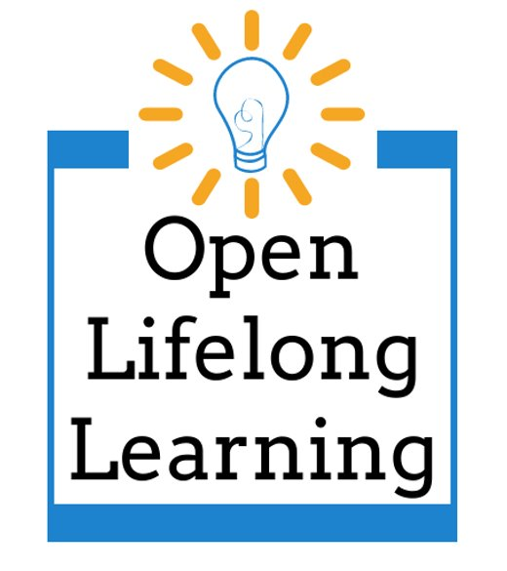
OER & Lifelong Learning: Creating a Measurement Instrument
Kathy Essmiller, Jamie Holmes, Caitlin Kelley, Marla Lobley

Slide 2
Purpose of the project
Create an outcome measure of OER that is not dependent on formal education settings (GPA, course grade, textbook cost savings, etc.)
Research question: Can competencies of lifelong learning be accurately measured through a self-report instrument?

Slide 3
Definitions
“Lifelong learning encompasses all learning activities undertaken throughout life with the aim of improving knowledge, skills and competences, within personal, civic, social or employment-related perspectives.” (EU, n.d.)
“The intention or aim to learn is the critical point that distinguishes these activities from non-learning activities, such as cultural or sporting activities.” (EU, n.d.)

Slide 4
Accepting of Ambiguity and Uncertainty
I believe solving problems often involves working through a period of not knowing what to do.
I believe there can be multiple solutions to one problem.
I get stuck if there is uncertainty when I am solving a problem.

Slide 5
Participation
Lifelong learning looks different in different contexts.
Visit this Goolge Doc to leave a comment on the current drafts of our survey items based on your context.

Slide 6
Adaptive Problem Solving
When faced with a complicated problem, I can use technology to make solving it easier.
When solving a problem, I often see how it is interrelated with other problems.

Slide 7
Applies Knowledge and Skills
I struggle to use what I have learned to solve issues in my daily life.
I frequently find myself applying what I learn in my everyday life.
I recognize ways in which I can apply new knowledge to varied problems.
The things I learn help me build skills that help with my daily life or work.
The things I learn often help me solve practical issues I encounter in daily life.

Slide 8
Aware of learning opportunities
I do not know where to find new learning opportunities.

Slide 9
Acknowledgement
This project was made possible in part by the Institute of Museum and Library Services LG-246348-OLS-20. ​ ​
The Institute of Museum and Library Services is the primary source of federal support for the nation's libraries and museums. We advance, support, and empower America’s museums, libraries, and related organizations through grantmaking, research, and policy development. Our vision is a nation where museums and libraries work together to transform the lives of individuals and communities. To learn more, visit www.imls.gov and follow us on Facebook and Twitter.

Slide 10
LIcense
OER & Lifelong Learning: Creating a Measurement Instrument © 2021 by Marla Lobley, Kathy Essmiller, Jamie Holmes, Caitlin Kelley is licensed under CC BY 4.0

