Slide 1
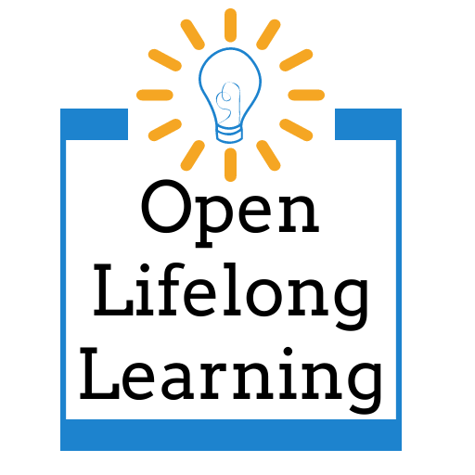
Many Minds Make Strong Research
Marla Lobley
Kathy Essmiller
Jamie Holmes
Caitlin Kelley

Slide 2
Definition
"The idea behind Open Science is to allow scientific information, data and outputs to be more widely accessible (Open Access) and more reliably harnessed (Open Data) with the active engagement of all the stakeholders (Open to Society)." (UNESCO, n.d.)
2020 OpenEd Presentation: OER's Efficacy in Developing Lifelong Learning Competencies
Creator: stux on Pixabay
Notes:
Jamie
Our idea was to create a research toolkit that can be used by anyone in the country to measure OER's efficacy in developing lifelong learning competencies. Making this happen requires participation of all stakeholders- students, practitoners from all parts of the country and different types of institutions. The rest of this presentation covers the details of how we're doing that. - all in the spirit of open science.
Presentation last year and part 3 coming next year
In the IMLS call for proposals itself, open science is valued...their language makes it's okay to take a risk and fail

Slide 3
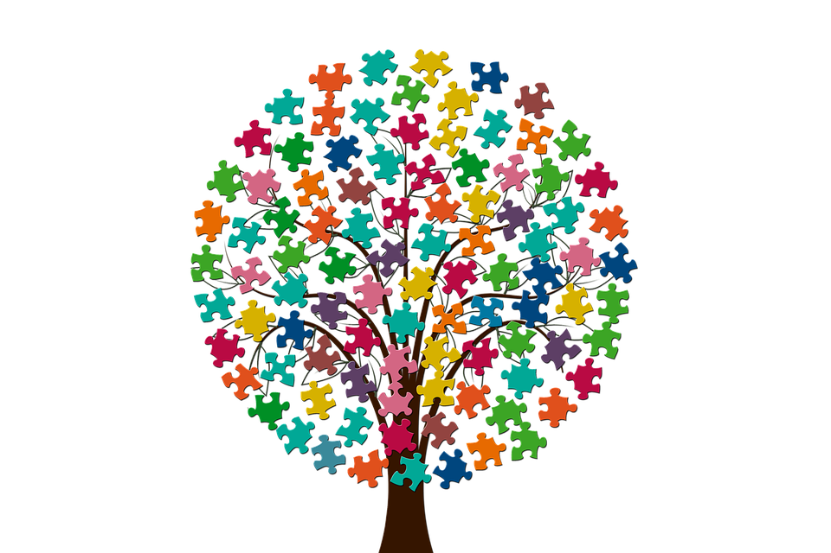
Value of Open Research
Diverse viewpoints
Project recognition & future use by stakeholders
Article and Data Sharing Requirements from federal agencies
Process > Product
Aligns with Open Practices
Creator: geralt on Pixabay
Notes:
Kathy "feedback from individuals and groups may cross-pollinate the projects", (Mersand 2021)
Diffusion of innovations theory, communication with people outside local network increases innovation, new ideas

Slide 4
Case Study
Information access
Stakeholder involvement
Network vs. Broadcast approach
Notes:
Marla
Sharing info- inviting feedback- direct research impact
Network approach vs. broadcast
Sharing in-progress, imperfect work
Targeted people outside the state
Information access
Created a project website & Twitter
Promoted to people in the community
Published summaries as infographics
Stakeholder involvement
Advisory Board meetings
Interactive presentations at state and national conferences
Multi-institutional research team
Call for people to submit items
Targeted requests for experts to review/analyze items

Slide 5
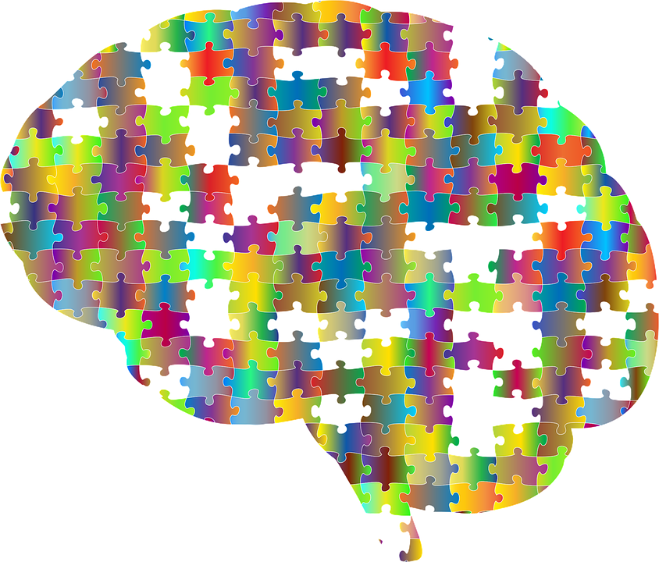
Practical Tools & Techniques
KardSort
Lawshe CVR Worksheet
Moodle
Open Science Framework
Research Methodology OER
SynCaps
Teams
Trello
Creator: GDJ on Pixabay
Notes:
Marla

Slide 6
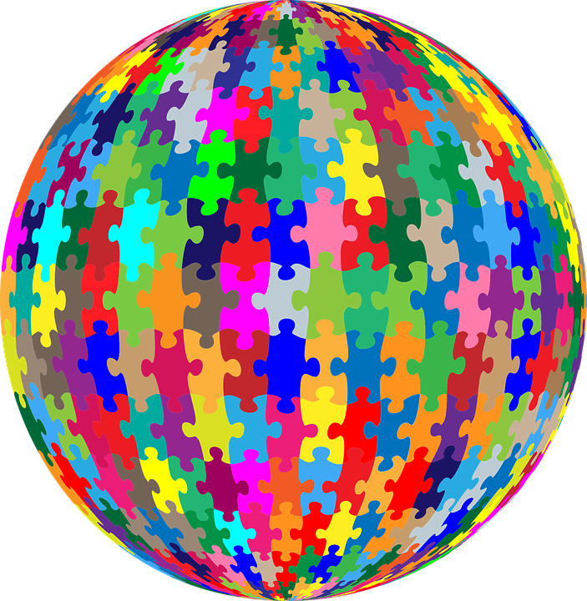
Lessons Learned
Checks & balances for credibility
Not all tools work as expected
Suited for flexibility
Embrace changes over time
Creator: GDJ on Pixabay
Notes:
Caitlin
Grad student perspective
3 year research project- changes are inevitable. Changes in personnel, overhead costs shift, etc. Open research makes these changes easier because can go back and look, etc. Jamie has brought in fresh perspective.
Jamie: I got to experience a valuable by-product of the open science praxis because I did join the project at the end of year one; I was able to follow their process easily while it was happening and all the open tools made it very easy for me to go back and access what I needed to jump in where they are now.

Slide 7
Stay Tuned!
Project Website
Twitter- @LifelongOpen
Tell us your next step for incorporating "open" in your formal or informal research! #OpenEd21
Notes:
Jamie:
We invite you to continue watching our process as we go through the remaining two years of the project. A link to our project website is there on the slide, which will be made available to you. You can follow our progress on twitter @LifelongOpen.
And we'd like to know how you're incorporating open into your research – we'll watch for the OpenEd hashtag!

Slide 8
Acknowledgements
This project was made possible in part by the Institute of Museum and Library Services LG-246348-OLS-20. ​ ​
The Institute of Museum and Library Services is the primary source of federal support for the nation's libraries and museums. We advance, support, and empower America’s museums, libraries, and related organizations through grantmaking, research, and policy development. Our vision is a nation where museums and libraries work together to transform the lives of individuals and communities. To learn more, visit www.imls.gov and follow us on Facebook and Twitter.

Slide 9
License
Many Minds Make Strong Research © 2021 by Marla Lobley, Kathy Essmiller, Jamie Holmes, Caitlin Kelley is licensed under CC BY 4.0

