Slide 1
Project Description
Grant through The Institute of Museum and Library Services (IMLS)
3-year research project evaluating an OER’s efficacy in developing lifelong learning competencies

Slide 2
Project Goals
Develop a Research toolkit
Increase number of robust academic studies
Increase diversity of the populations studied
Produce a Research methodology OER for librarians

Slide 3
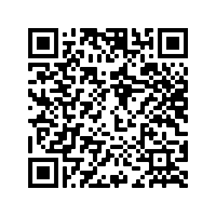
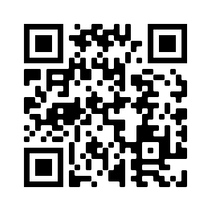
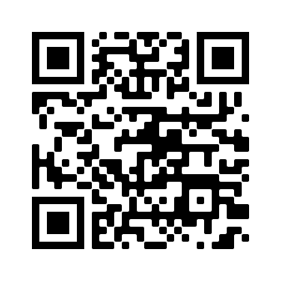
Resources
Handout describing the grant application process.
​
Follow the project and continue to give feedback on Twitter and Moodle!​
Handout
Twitter
Moodle
Notes:
The handout describes how we have collaborated on the grant proposal and what features of the proposal seemed most successful.
A major component of the project is to gather feedback from other professionals. We welcome all feedback at our Twitter and Moodle.

Slide 4
Acknowledgement
This project was made possible in part by the Institute of Museum and Library Services LG-246348-OLS-20.
The Institute of Museum and Library Services is the primary source of federal support for the nation's libraries and museums. We advance, support, and empower America’s museums, libraries, and related organizations through grantmaking, research, and policy development. Our vision is a nation where museums and libraries work together to transform the lives of individuals and communities. To learn more, visit www.imls.gov and follow us on Facebook and Twitter.

Slide 5
License
Open Lifelong Learning © 2021 by Marla Lobley, Kathy Essmiller, Jamie Holmes is licensed under CC BY 4.0

